Slide 1

2016-2017
Résumé/CV Guide
Undergraduate Programs
Hult International Business School
© 2016-2017

Slide 2
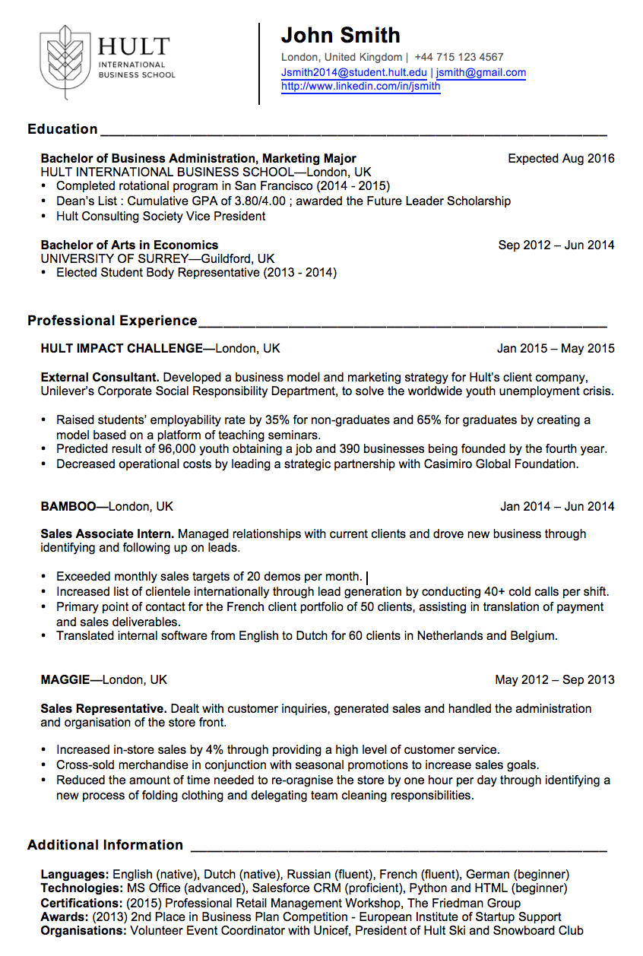
Header
Education
Recent Experience
Relevant Info
Copyright © 2016-2017 Hult International Business School.

Slide 3
Fonts and Styles
Arial is the Hult International Business School house font for CV text. Bold or italic styles will be indicated per section as well as the point size and line breaks.
Paper size is US letterhead (8.5 x 11 inches) which is slightly smaller than the United Kingdom A4 size.
Important note: Do not include age, gender, birthday, marital status, nationality or a photo of yourself in the CV for the Hult Corporate Relations version of your CV. You may adapt your CV for personal usage outside of Corporate Relations.
Tips
If you have the right to work in a country other than your own, please indicate that in your CV under the Additional Information section (e.g., Work Authorization: USA visa)
Ensure even spacing before and after | symbols
Use US letterhead size paper (8.5 x 11 inches)
Left justification, not full justification of text in the body
Verify all headers are aligned correctly with text for body indented
Keep the HULT logo within printable regions
Know when to use apostrophes and when not to (e.g. its vs. it’s)
“Master” degrees are not plural (e.g. Master of International Business not…Masters)
Verify the local common way to display the area code in your phone number
Remove all hyperlinks and color except for the e-mail addresses and LinkedIn URL in the header
Copyright © 2016-2017 Hult International Business School.

Slide 4

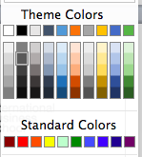
Header
u
v
u
Hult logo is provided in the template.
First name and last name = Arial 18 pt.
Contact information = Arial 9 pt. gray tone (see color).
City, [State if applicable] and country are followed by 2 spaces
Insert a | (pipe symbol) between location and phone followed by 2 spaces
Phone number includes the country code and uses hyphens between digits
Hult email address is provided first, followed by personal email. Hult email convention will be first initial last name followed by year then @student.hult.edu. (jsmith2016@student.hult.edu)
A pipe symbol is used between the two email addresses
An abbreviated LinkedIn profile URL is required. To abbreviate your LinkedIn profile URL, click the Privacy and Settings link. https://help.linkedin.com/app/answers/detail/a_id/87
The name is separated from the logo in a table (2 column) with a black line border on the left cell border. When editing, just click to edit the text directly to replace the existing name and contact info.
v
Copyright © 2016-2017 Hult International Business School.

Slide 5
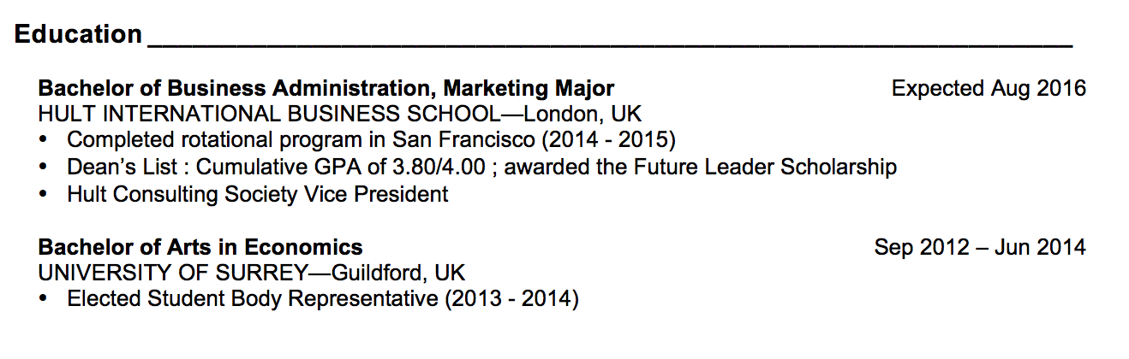
Education
u
v
u
Education header = Arial, 12 pt. Bold followed by a line that stretches to the right margin. There is one line break below the header before the university list. Two line breaks are used between sections of the CV.
You may list any number of university degree programs starting with the most recent first (Hult International Business School). Font is Arial 10 pt.
Degree program = Arial 10 pt. Bold with initials for program in parentheses (e.g. MBA).
University = regular, Arial 10 pt. followed by a space then | then space, then city, state or country
The month and year of graduation is aligned with the margin on the right side.
All Hult programs assume an “expected” graduation date (month year).
Any activities or Dean’s List designations are in a bullet below the school (left .15 and hanging .18)
v
Copyright © 2016-2017 Hult International Business School.

Slide 6
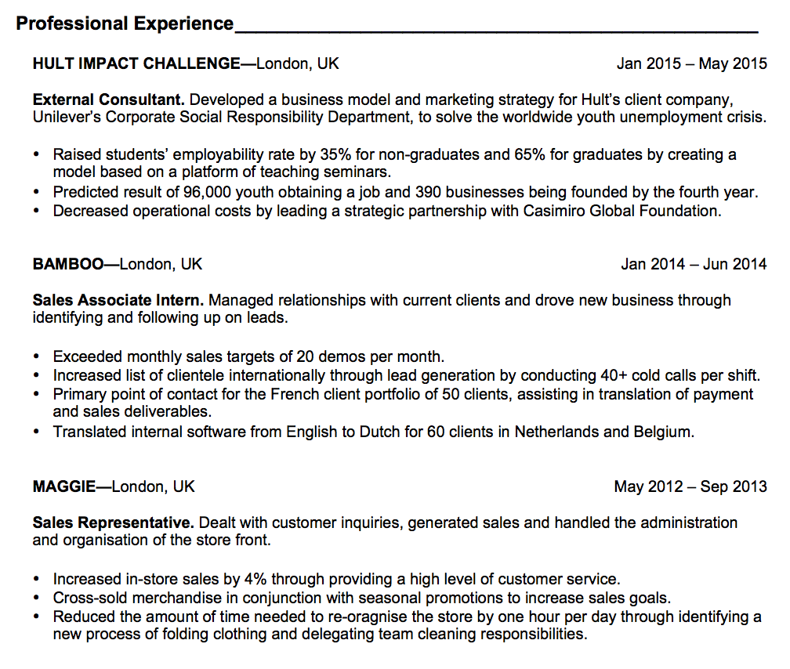
Experience
u
Note:
If you have more than one role in a single company, please repeat the role and bullets for the second or third role under the same company header with date ranges in parentheses.
v
u
Experience header = Arial, 12 pt. Bold followed by a line that stretches to the right margin. There is one line break below the header before the company name.
Company Name = Arial 10 pt. Bold ALL CAPS
Use an em dash — after the company and before the city, country (not bolded text for location)
Bullets are indented .38cm
All bullets end in a period.
Please see appended file for action words and C.A.R. statements for the most impactful way to create your bulleted list of accomplishments focused on “results.”
* For students with 0 years experience, you may use Volunteer Experience or Student Projects and include your results and key accomplishments for volunteer or internship roles.
v
Copyright © 2016-2017 Hult International Business School.

Slide 7
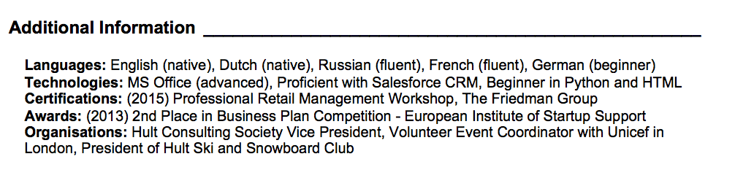
Additional Information
u
v
u
Additional Information header = Arial, 12 pt. Bold followed by a line that stretches to the right margin. There is one line break below the header before the first skill. There are 2 line breaks between sections of the CV.
Skills category labels may include:
Work Authorization=Arial 10 pt. Bold followed by a colon, then the country or countries
Languages = Arial 10 pt. Bold followed by a colon, then the list with proficiency levels in parentheses
Certifications= Arial 10 pt. Bold followed by a colon, then the list
Technologies= Arial 10 pt. Bold followed by a colon, then the list
Affiliations= Arial 10 pt. Bold followed by a colon, then the list
Social= Arial 10 pt. Bold followed by a colon, then the list
No period at the end of additional information phrases (e.g. Languages: English, Hindi)
v
Copyright © 2016-2017 Hult International Business School.

